Slide 1
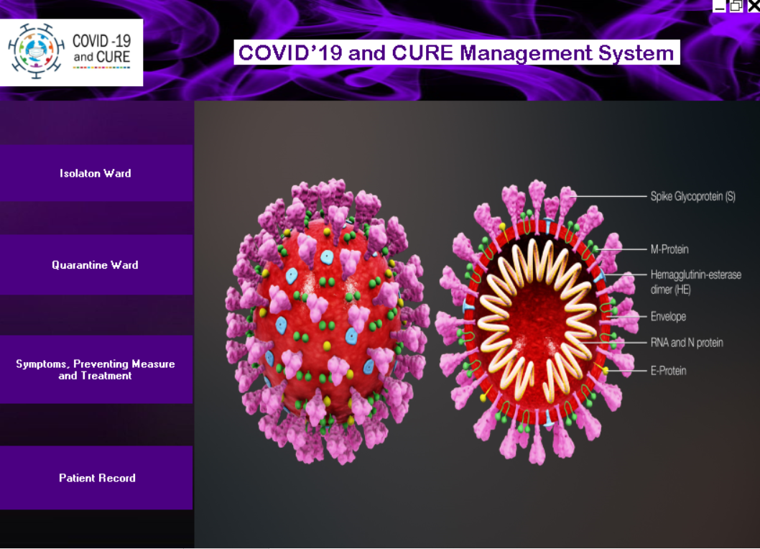
Menu:
When we execute it shoes menu

Slide 2
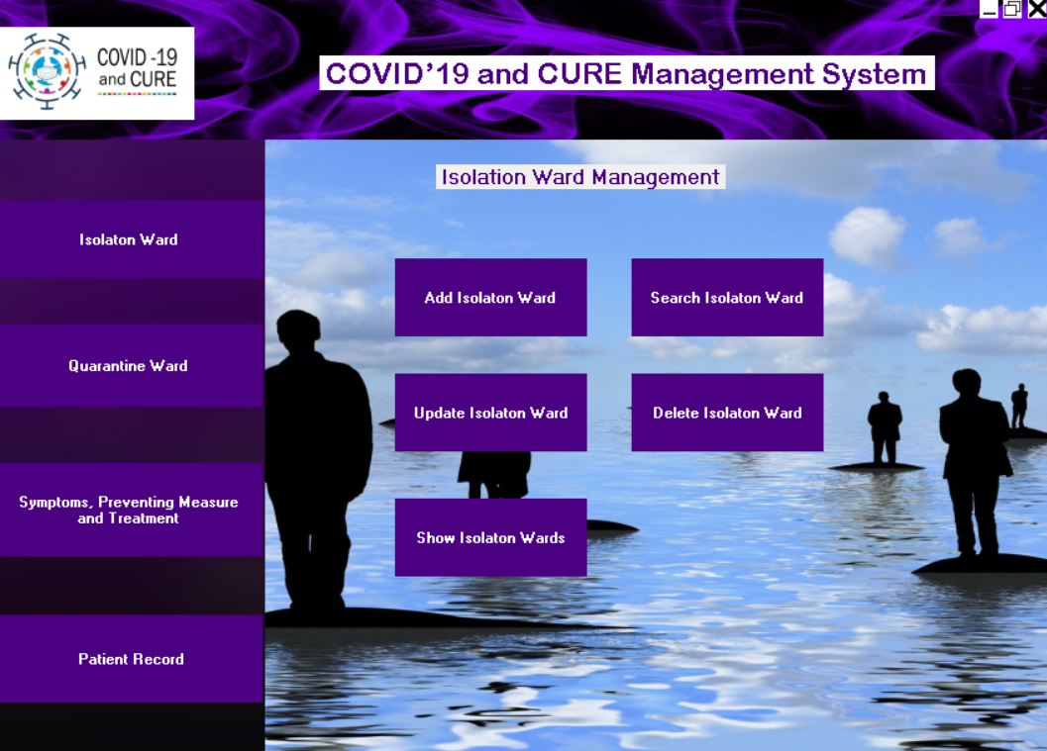
Isolation Ward Management:

Slide 3
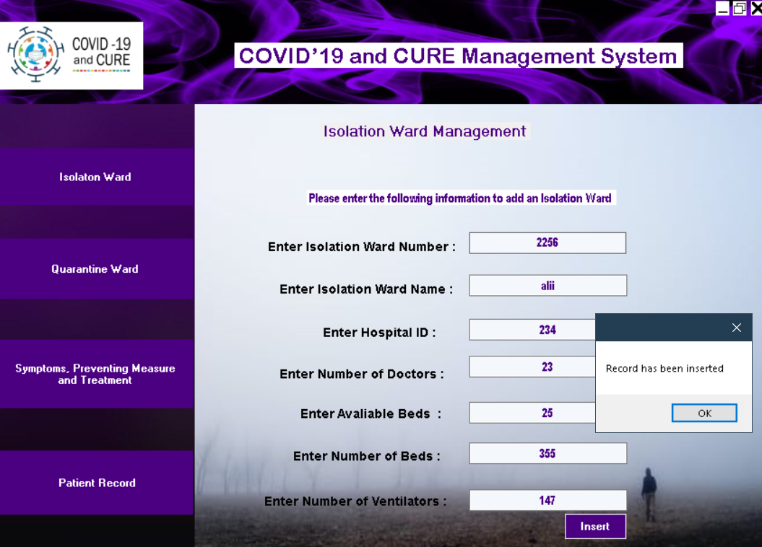
Add Isolation Ward:

Slide 4
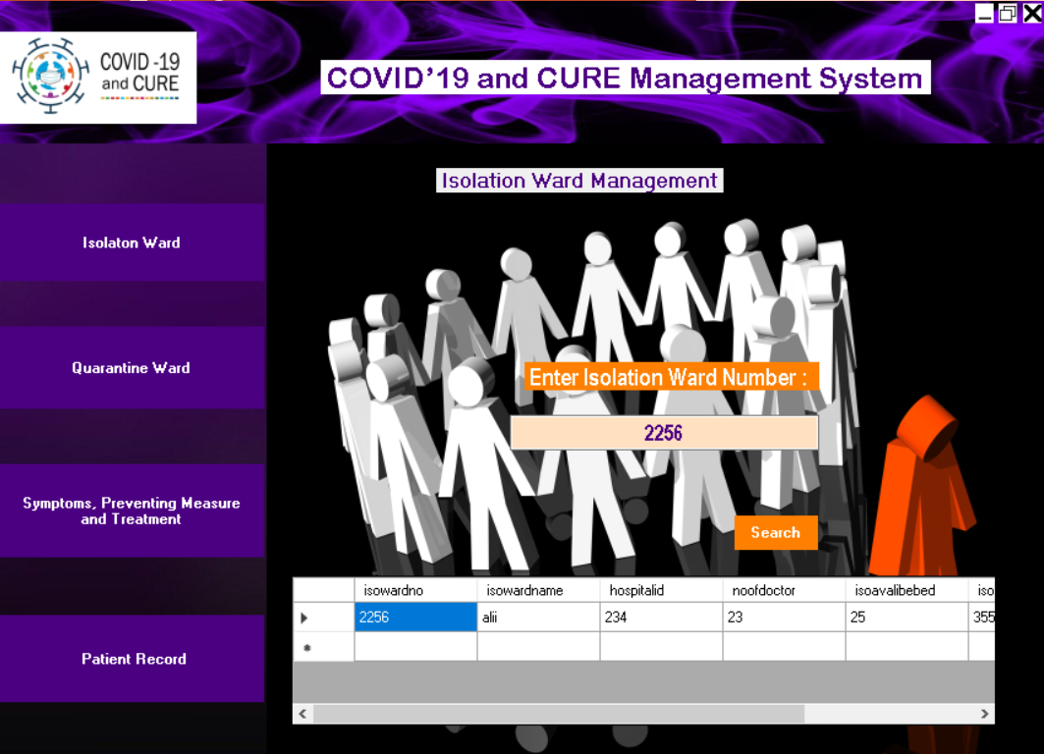
Search Isolation Ward:

Slide 5
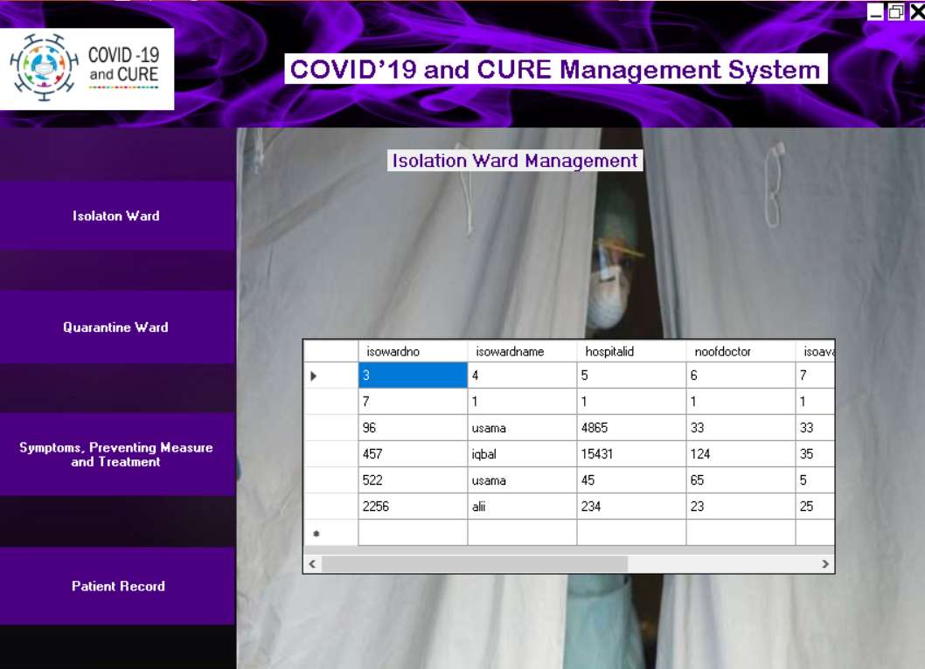
Show Isolation Ward:

Slide 6
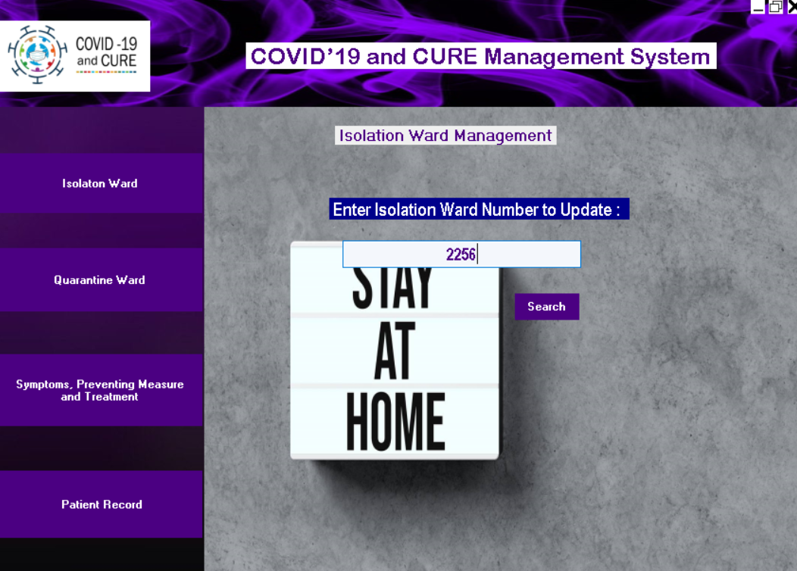
Update Isolation Ward:

Slide 7
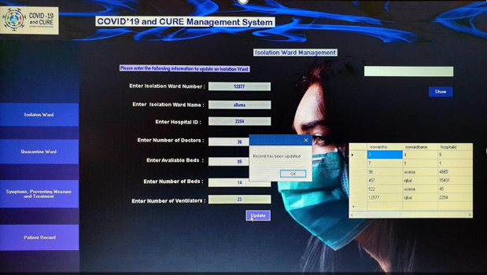
Update isolation Ward:

Slide 8
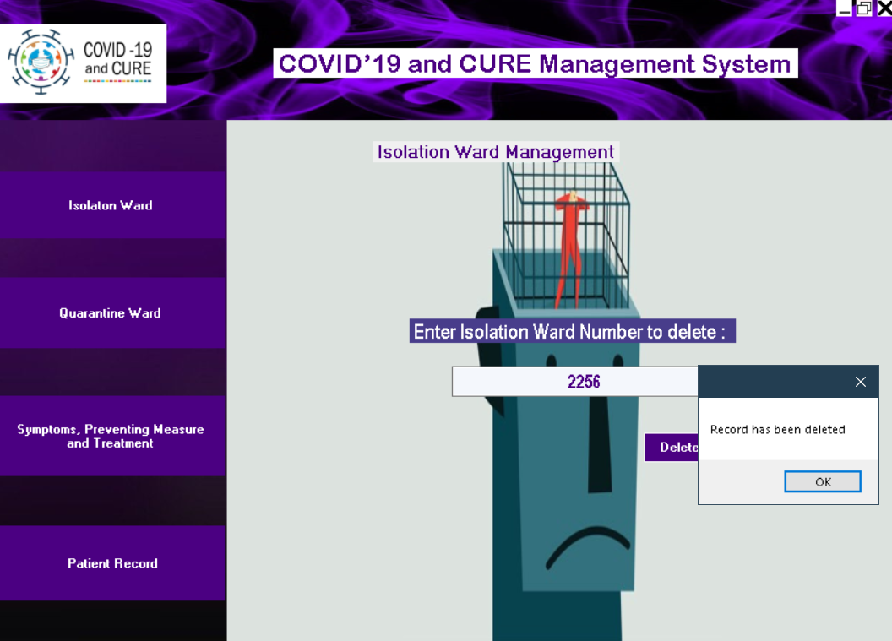
Delete isolation Ward:

Slide 9

Quarantine Ward Management:

Slide 10
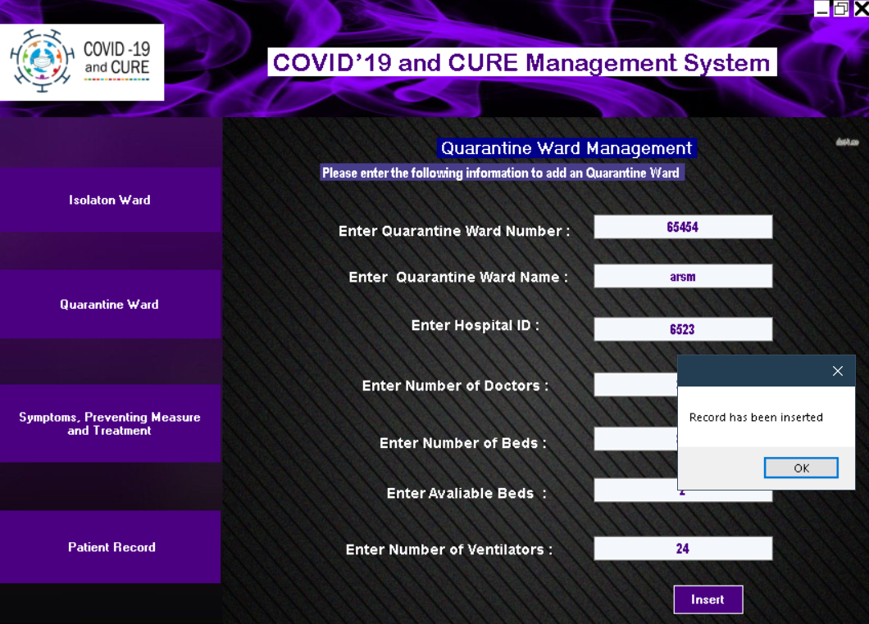
Add Quarantine Ward:

Slide 11
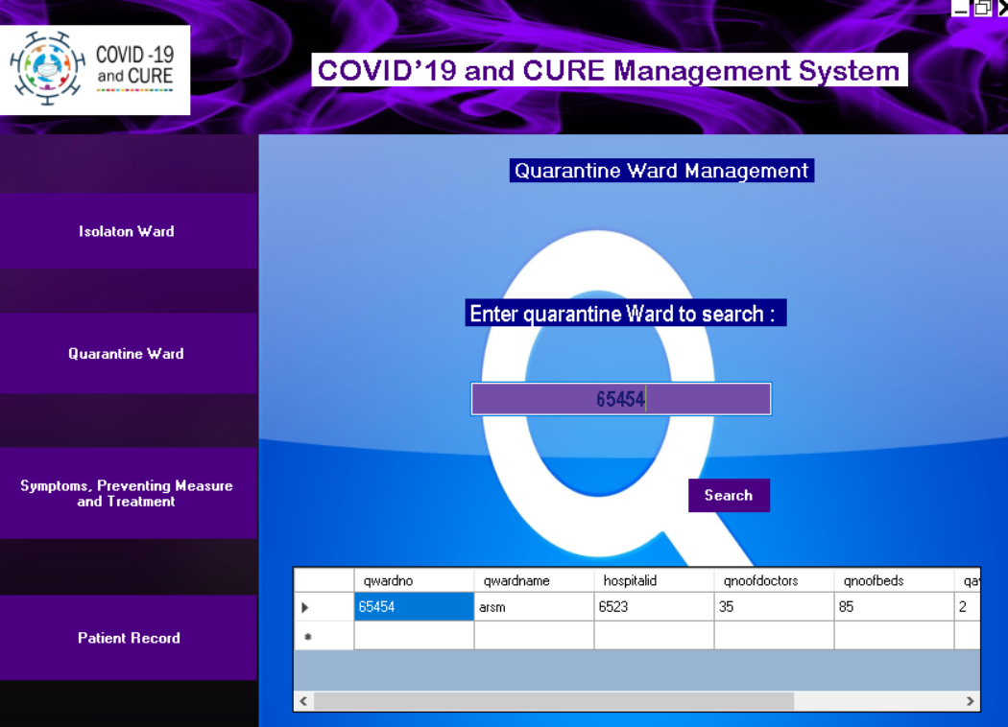
Search Quarantine Ward:

Slide 12
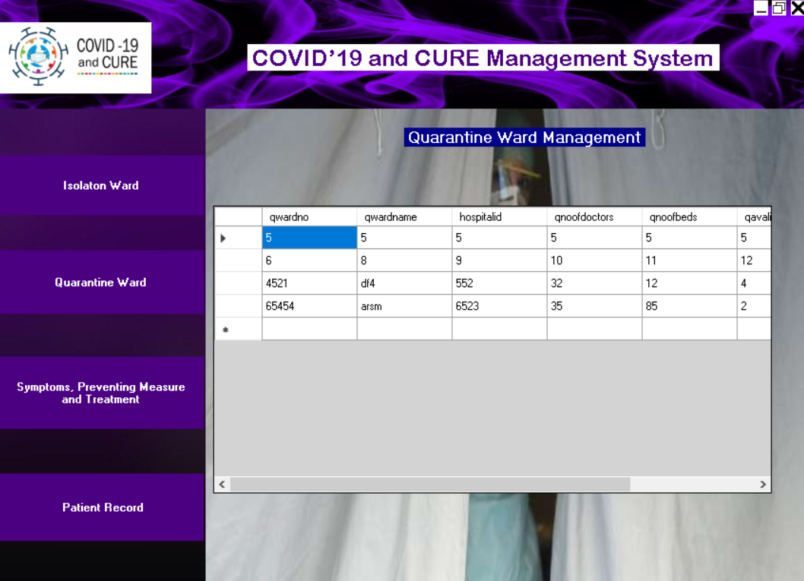
Show Quarantine Wards:

Slide 13
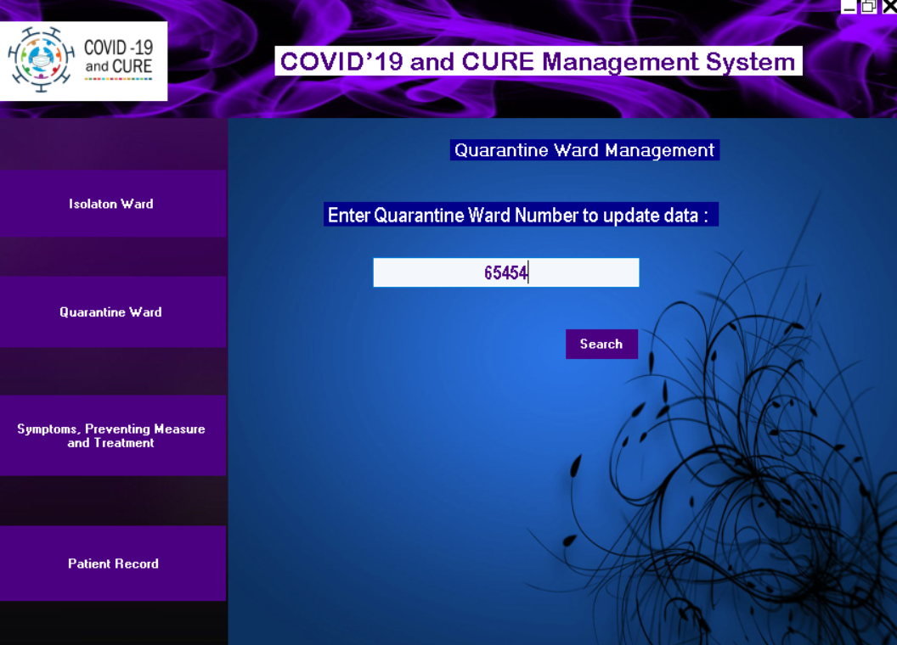
Update Quarantine Ward:

Slide 14
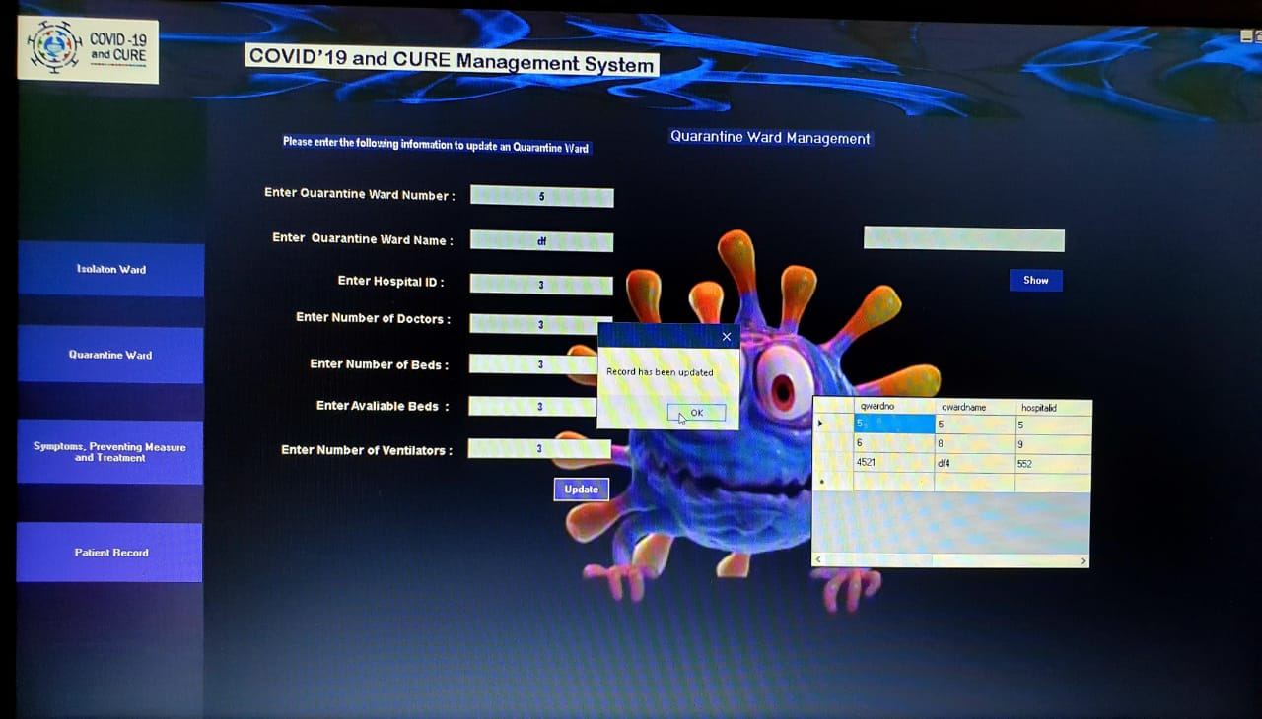
Update Qurarantine:

Slide 15
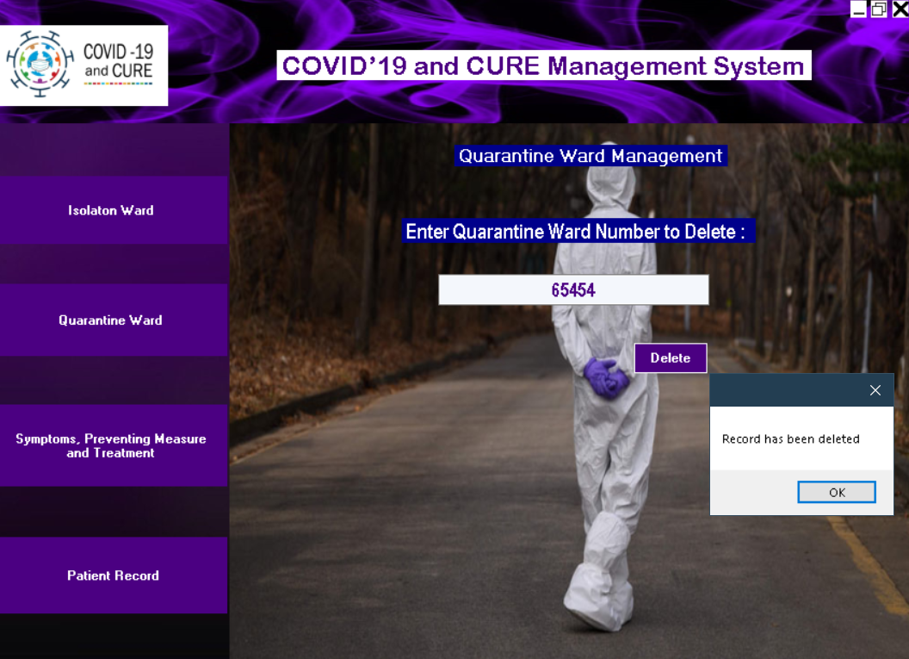
Delete Quarantine Ward:

Slide 16
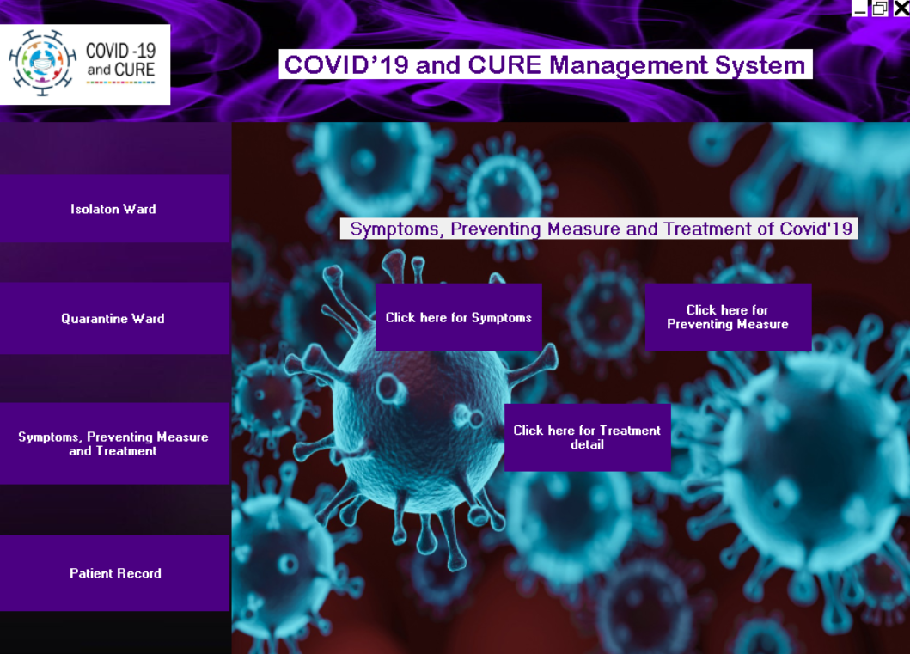
Symptoms, preventing measures, Treatment

Slide 17
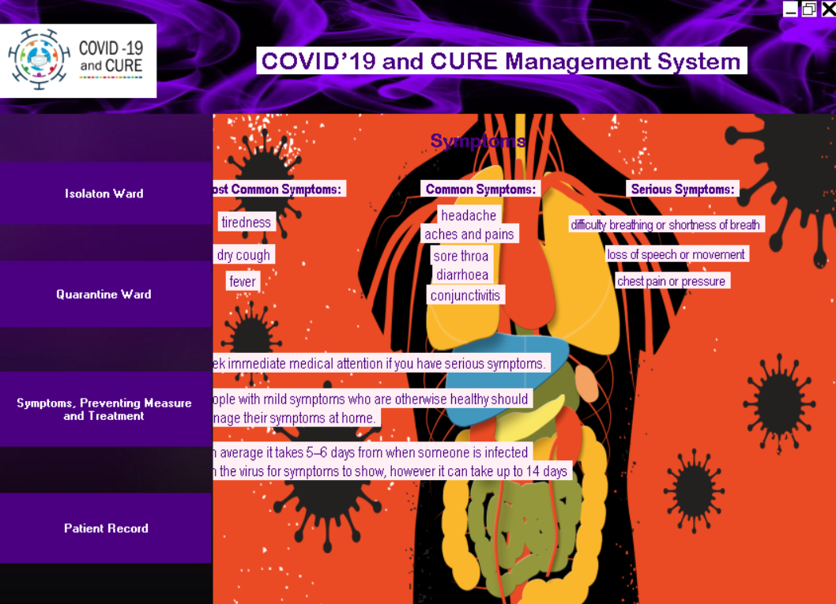
Symptoms

Slide 18
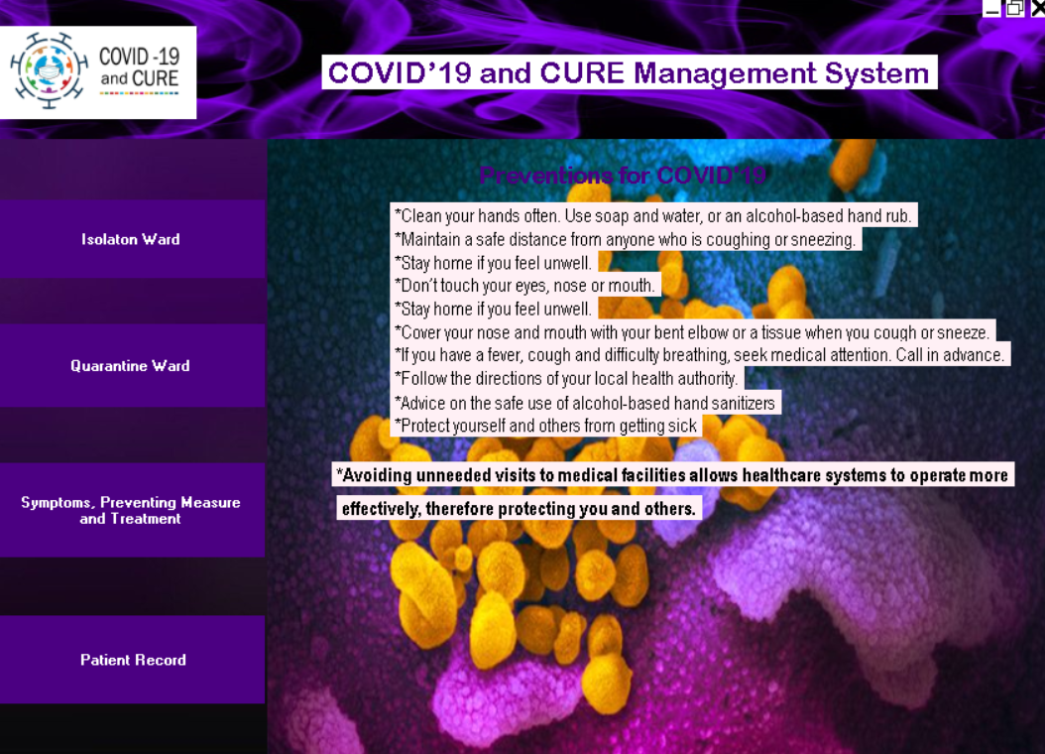
Preventing measures:

Slide 19
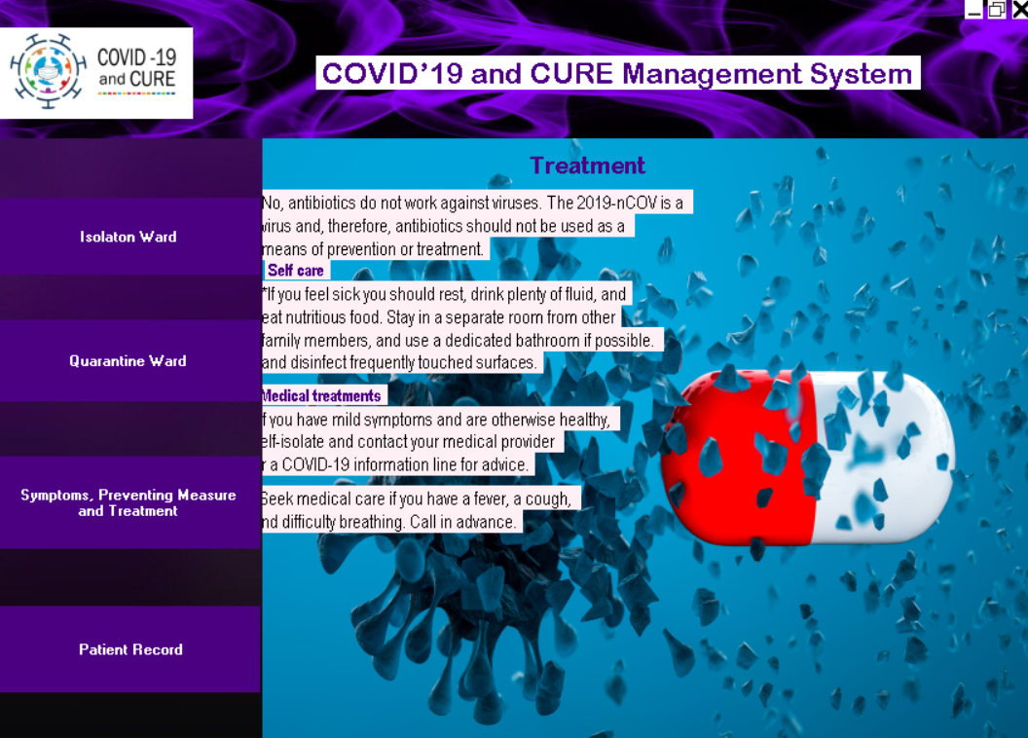
Treatment

Slide 20
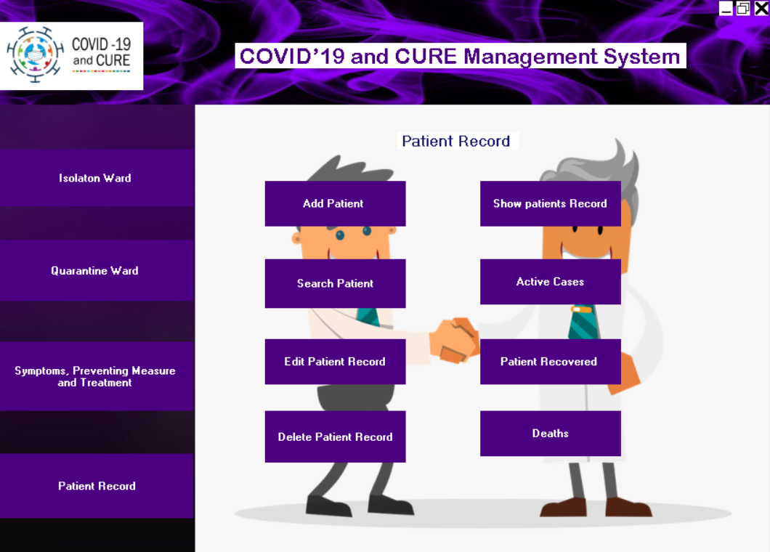
Patient Record:

Slide 21
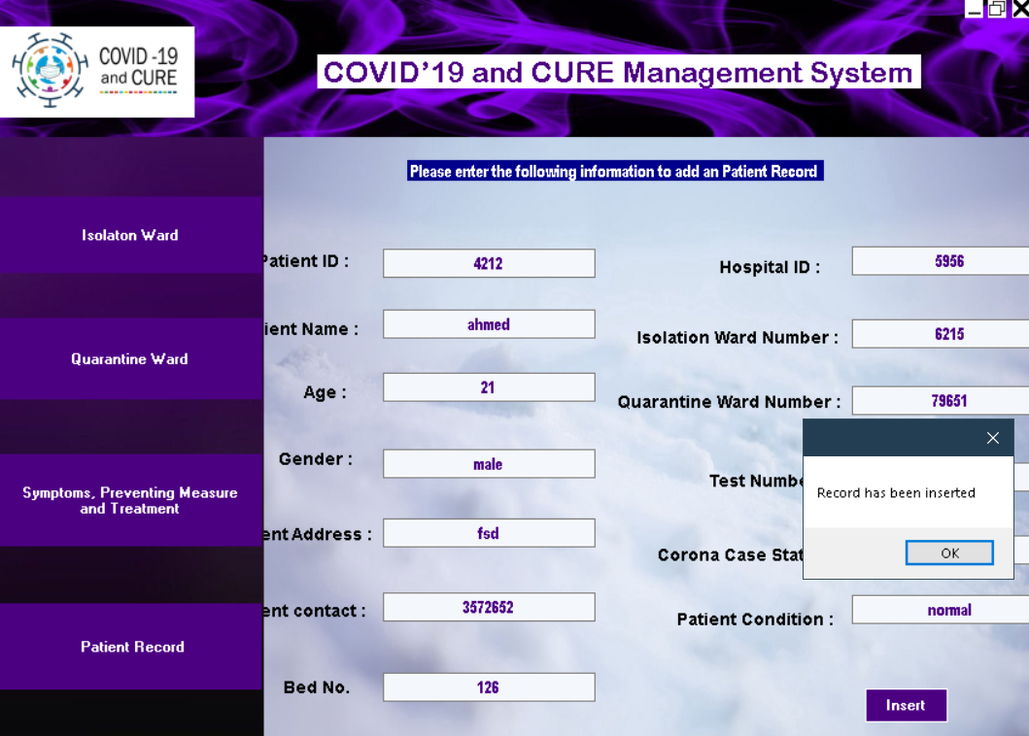
Add Patient:

Slide 22
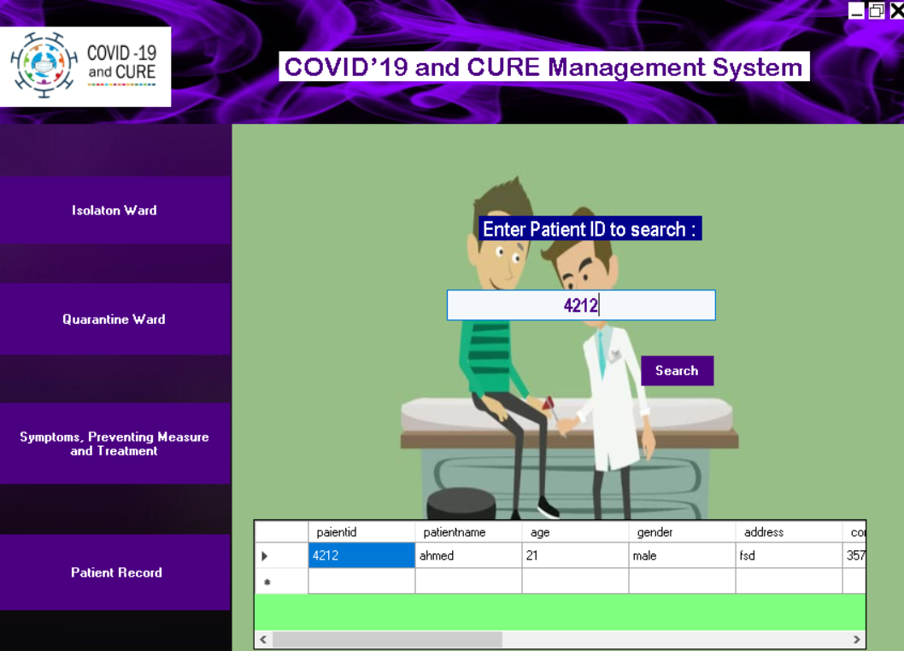
Search patient:

Slide 23
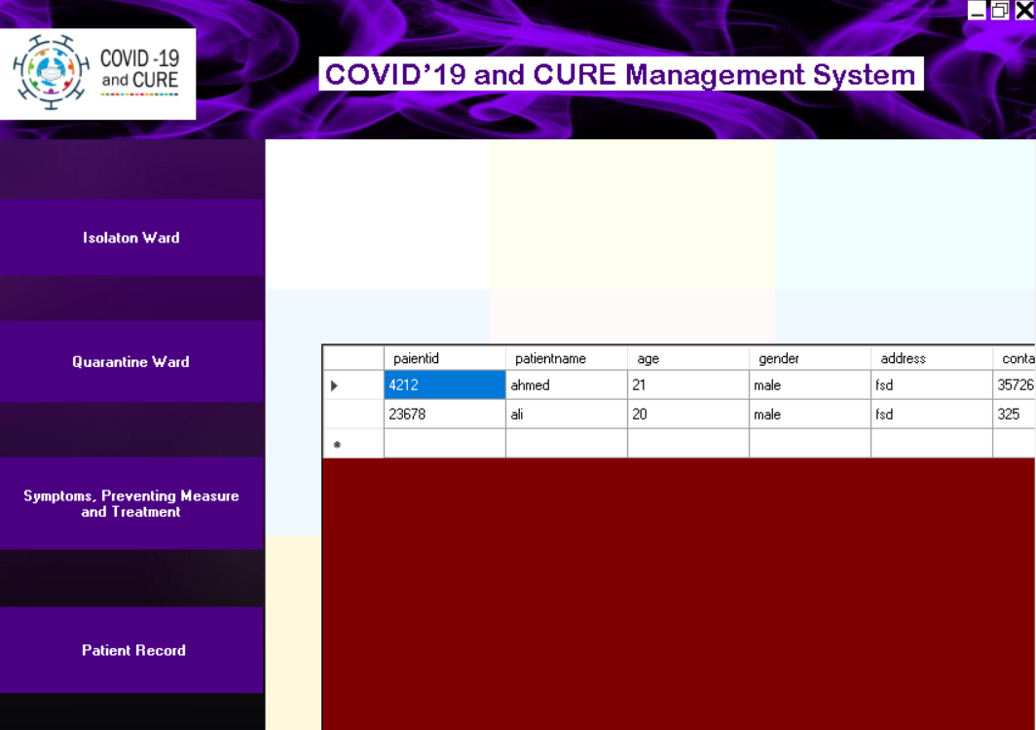
Show patient:

Slide 24
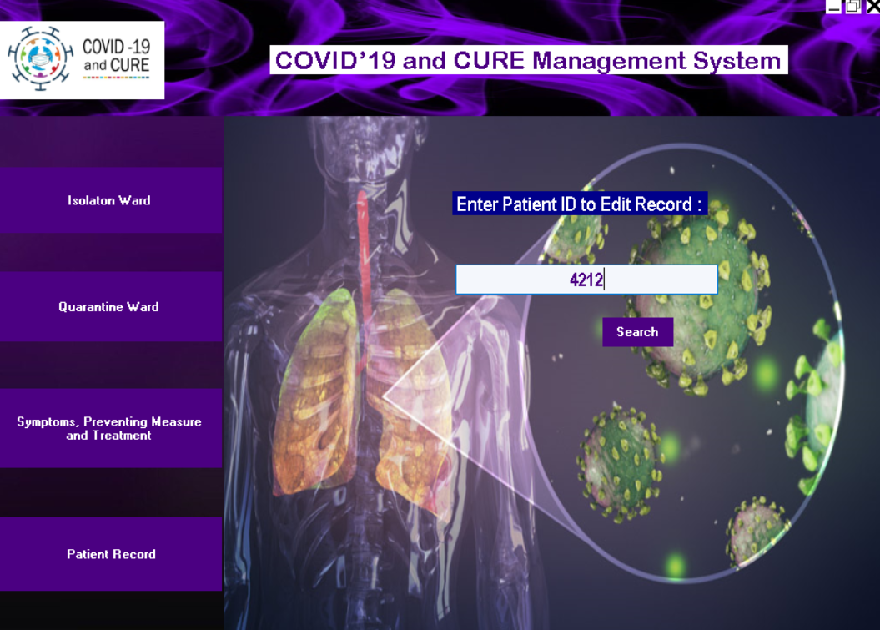
Update patient:

Slide 25
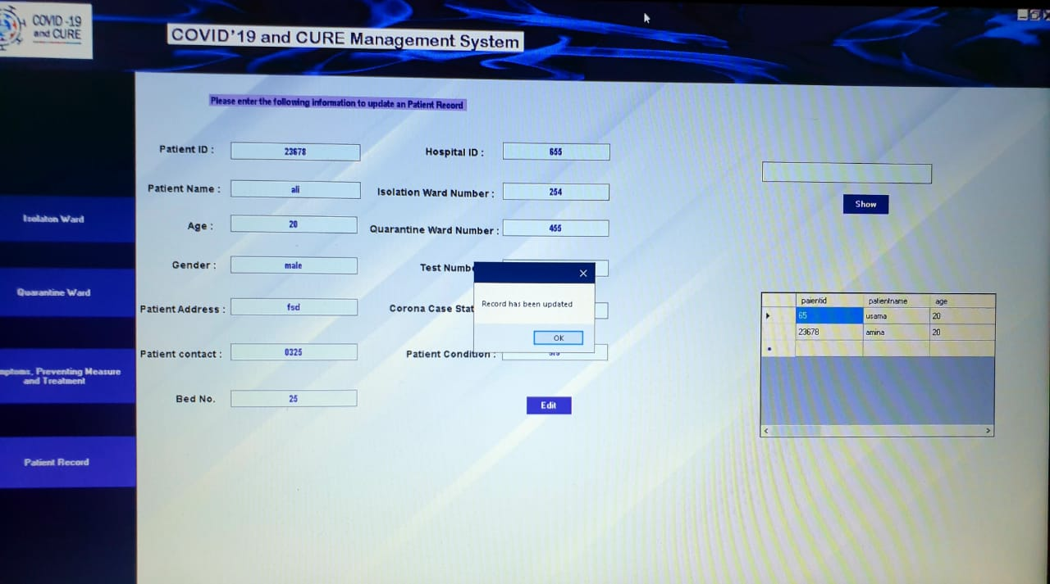
Update Patient Record:

Slide 26
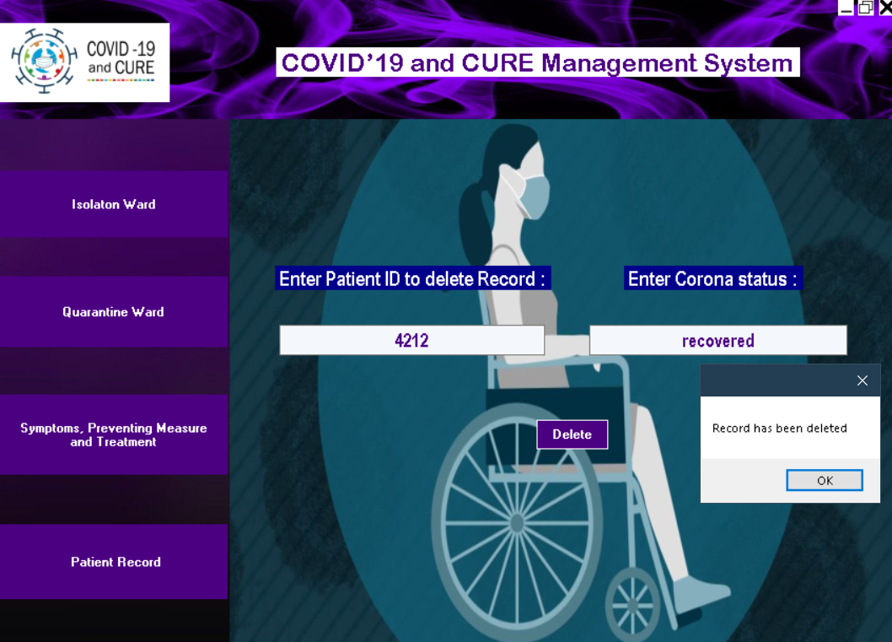
Delete Patient:

Slide 27
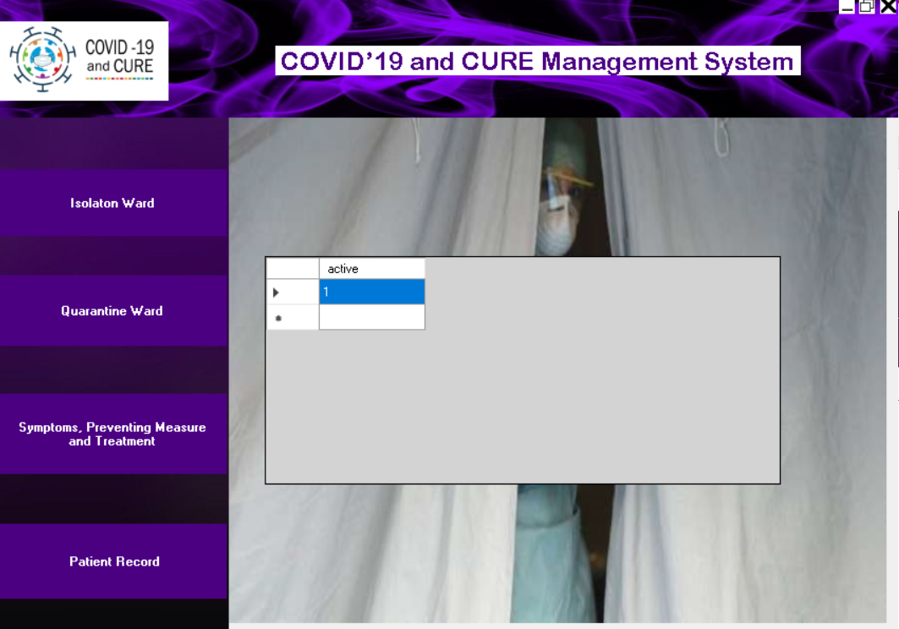
Active cases:

Slide 28
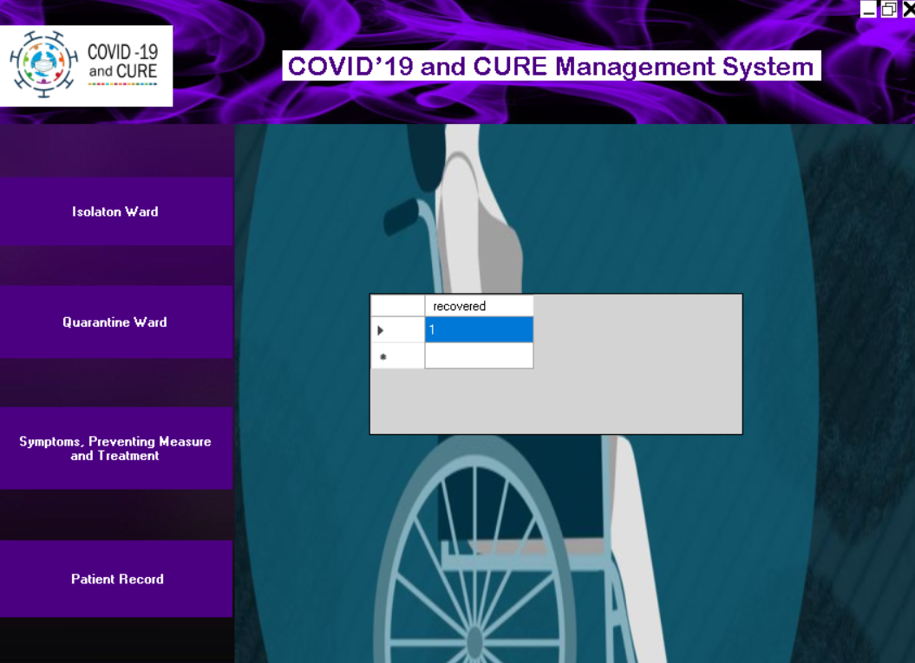
Recovered Cases:

Slide 29
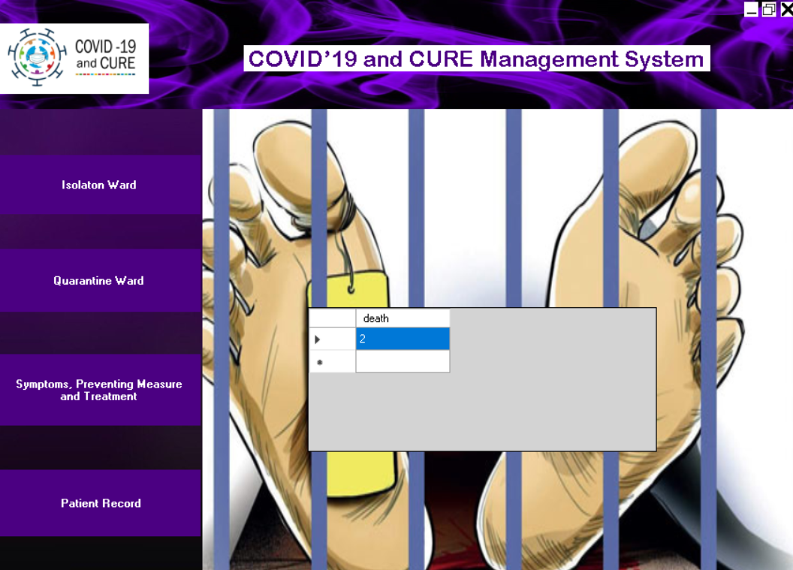
Death cases:

Slide 30

This is all from our side! THANK YOU

